Slide 1

RELIANCE INDUSTRIES STOCK FORECAST
Presented By : Group 5
Megha N Kerur
Bhavana Kurabet
Nikita Manoj Khalane
Mahesh Rajaram Ushir

Slide 2
OBJECTIVES
Predict the Reliance Industries Stock Price for the next 30 days.
There are Open, High, Low and Close prices that you need to obtain from the web for each day starting from 2015 to 2023 for Reliance Industries stock.
Split the last year into a test set- to build a model to predict stock price.
Find short term, & long term trends.
Understand how it is impacted from external factors or any big external events.
Forecast for next 30 days.

Slide 3
DATA COLLECTION
For this project, we will be using the Yfinance library to get the data, which makes it easy to process.
We collected data from 1-Jan-2015 to 31-Dec-2023.
But also you can download data from ‘Yahoo! Finance’ website. You can use Below link.
https://query1.finance.yahoo.com/v7/finance/download/RELIANCE.NS?period1=946684800&period2=1691971200&interval=1d&events=history&includeAdjustedClose=true

Slide 4
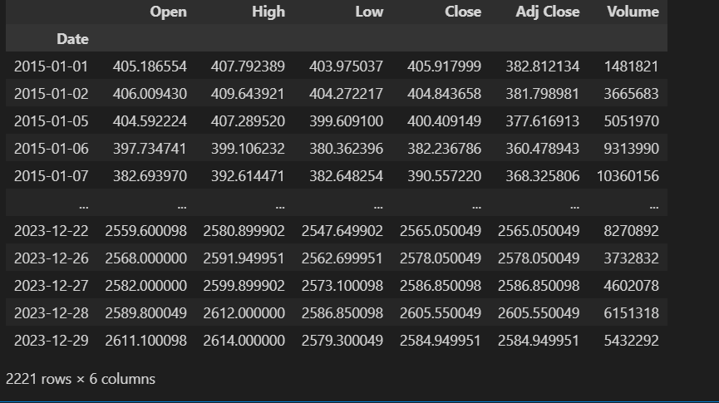

Slide 5
EDA
For this dataset there were Zero null values.
There were zero duplicate records in the dataset
‘Date’ column was not in datetime datatype, it was in object so we changed it into datetime
Set ‘Date’ column as index column for visualization purpose
There was no need of ‘Adj Close’ column so we removed it

Slide 6
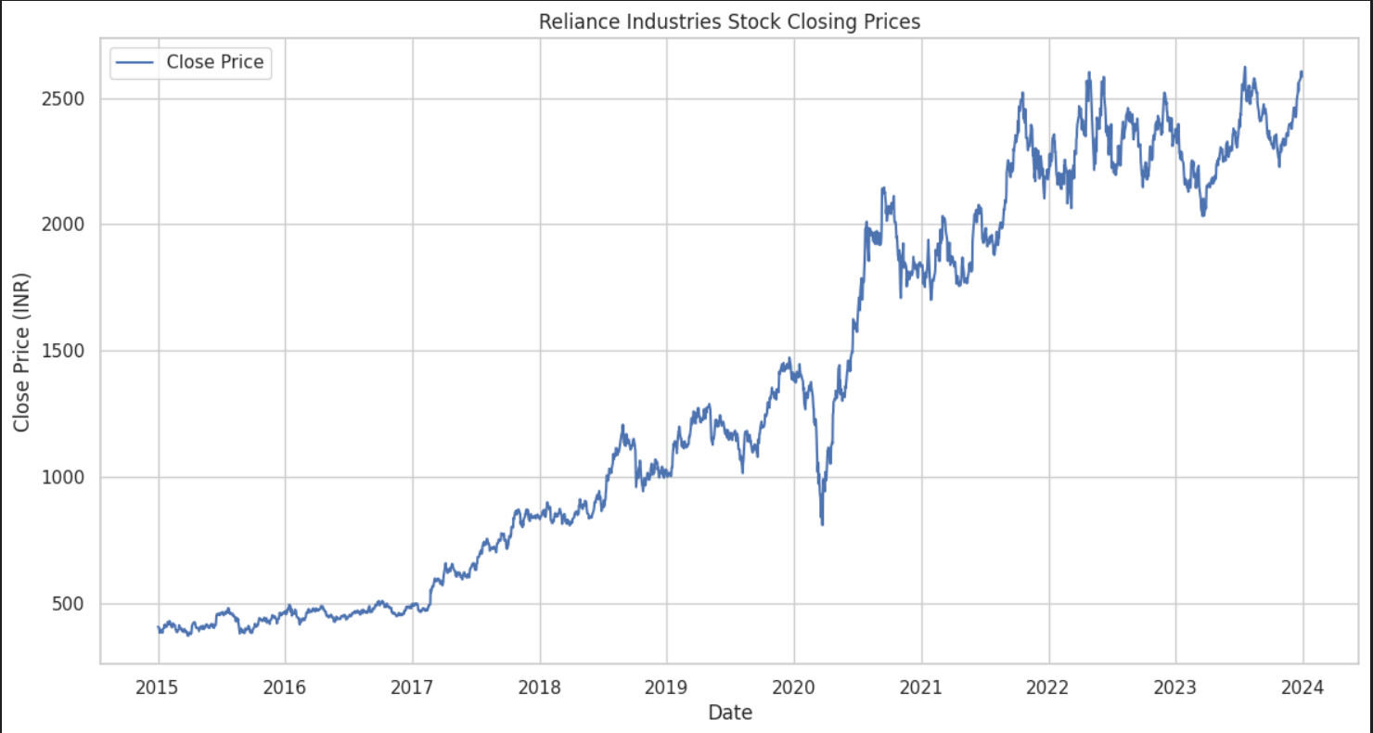
Visualization
‘Close’ column plot according to Indian Rupee

Slide 7
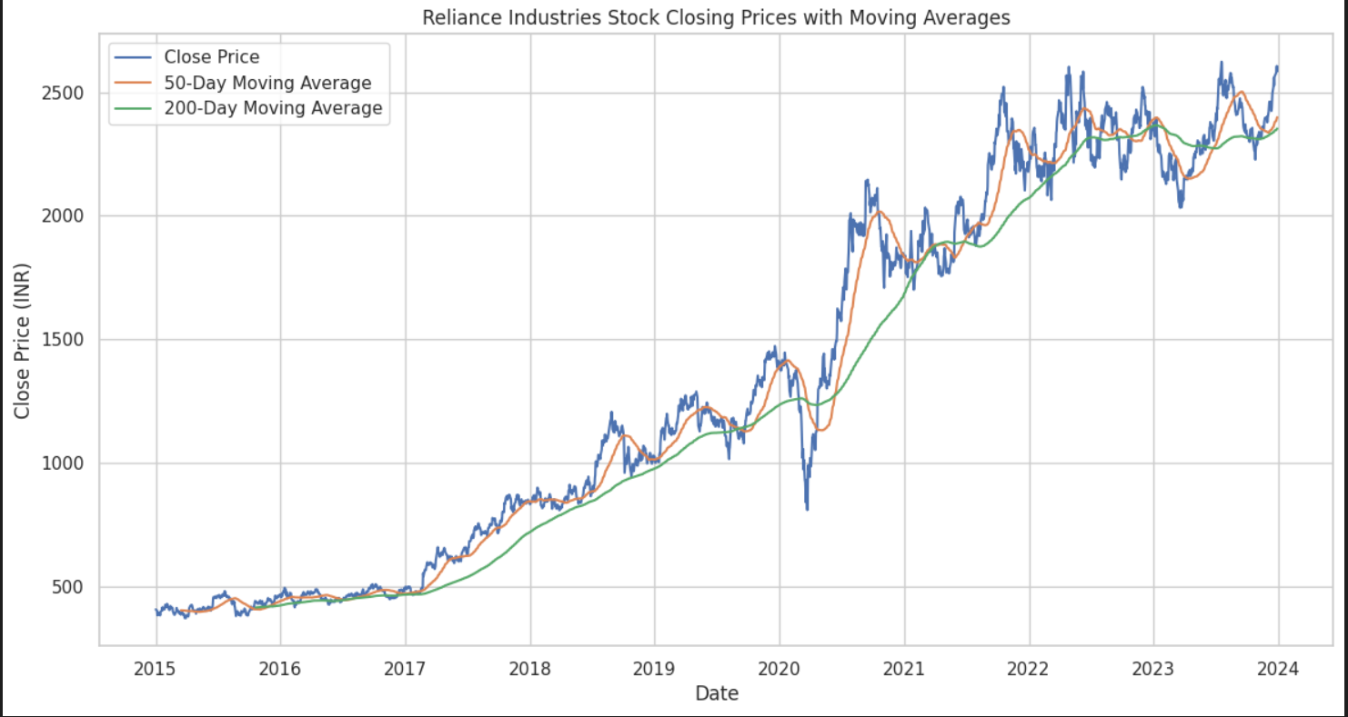
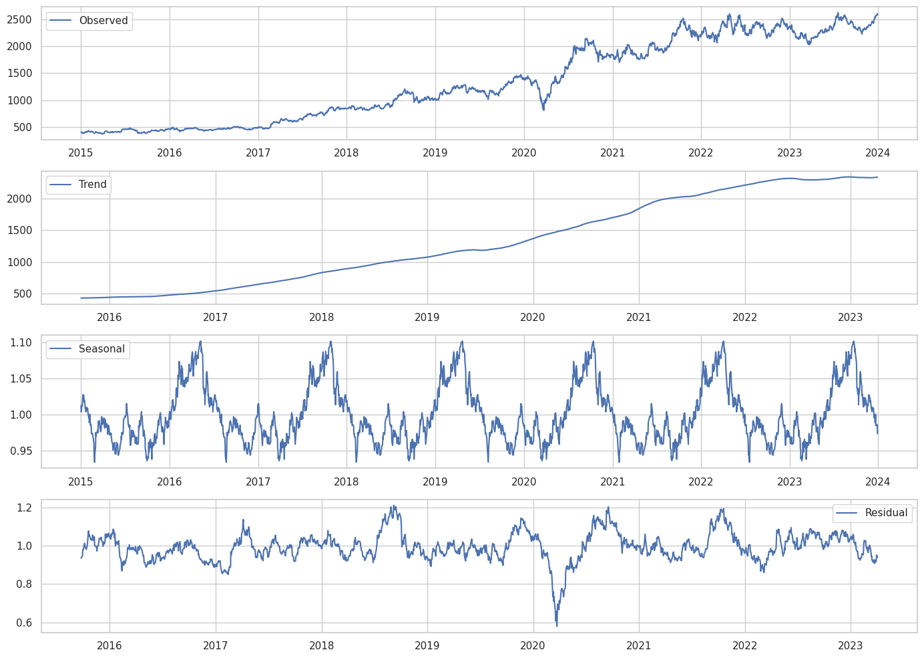
Reliance Industries Stock Closing Price with Moving Averages
Trend and Seasonality Plots

Slide 8
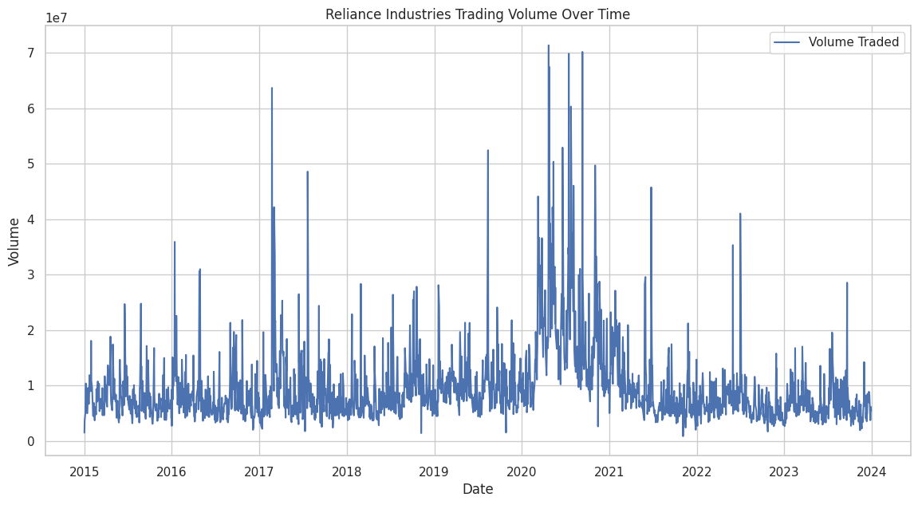
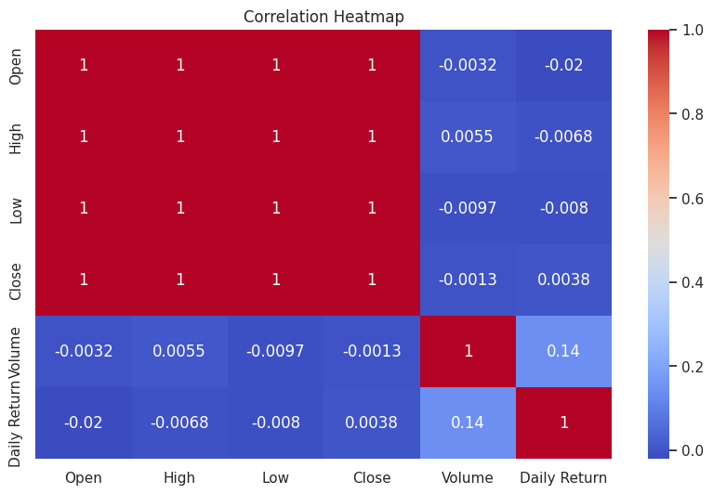
Reliance Industries Trading Volume Over a Time

Slide 9
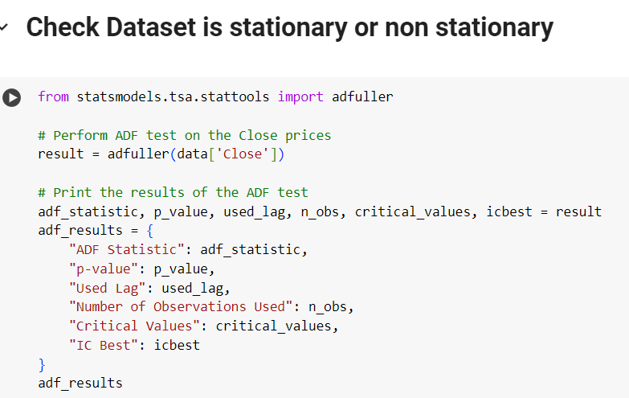
Stationarity check-Differenced series
RESULTS
ADF Statistic: -0.4226880712518032
p-value: 0.9062412080949075
Used Lag: 5
Number of Observations Used: 2215
Critical Values:
{'1%': -3.4333057085868255,
'5%': -2.8628457425162424,
'10%': -2.567465109783999}
IC Best: 20378.014588427934

Slide 10
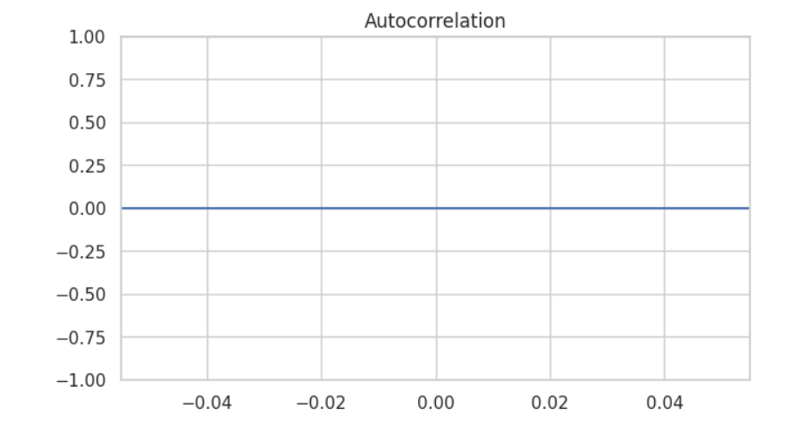
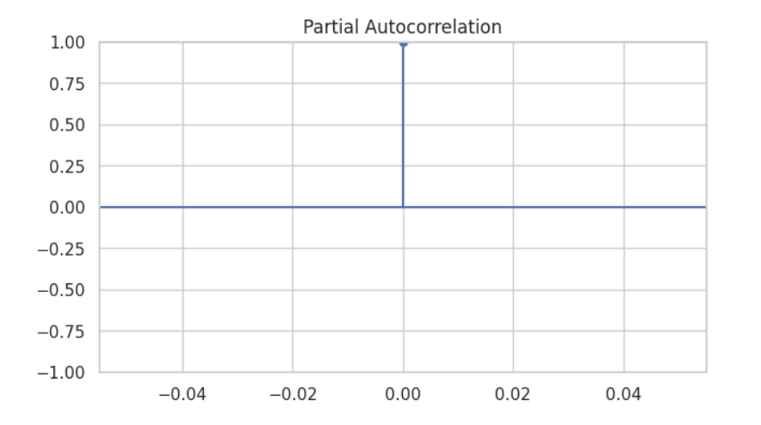
ACF and PACF Plots

Slide 11
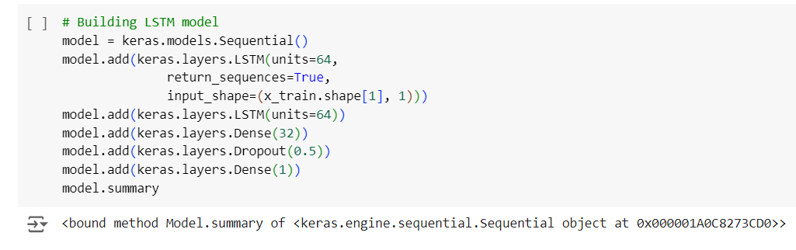
Model Selection

Slide 12
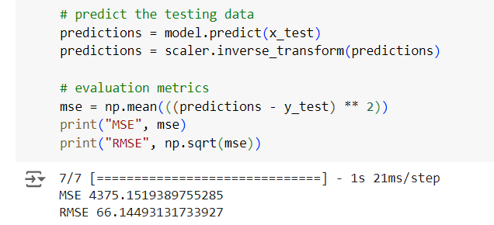
Prediction and Evaluation

Slide 13
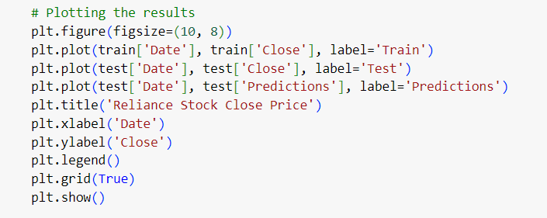
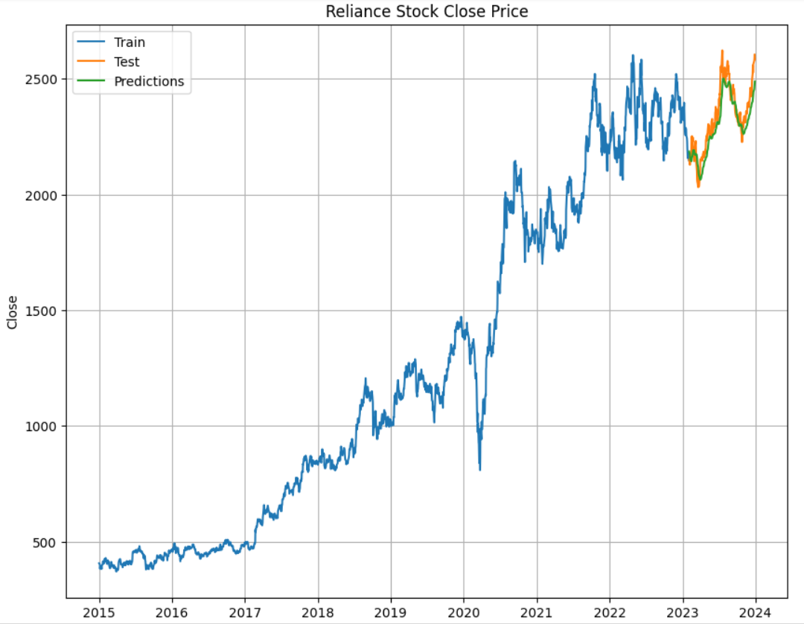
Plotting the results

Slide 14
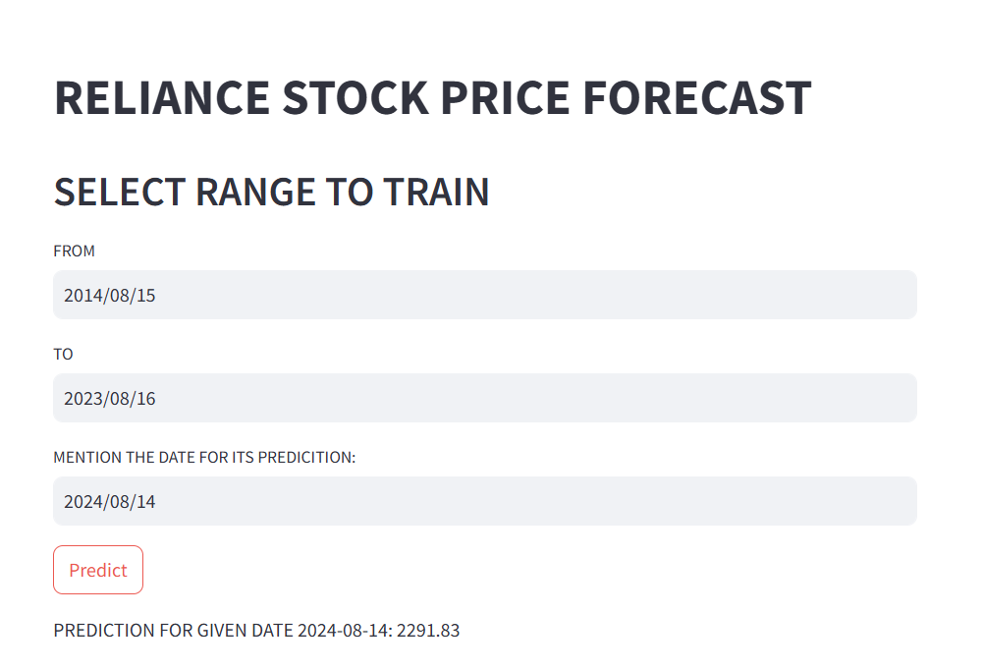
Model deployment

Slide 15
Challenges faced
The need to scale the data properly, especially for the LSTM model, to prevent any single feature from dominating the learning process.
Choosing the Right Model: Selecting the appropriate models (LSTM, ARIMA) involved balancing between capturing complex patterns (LSTM) and simplicity (ARIMA).
Overfitting: Ensuring that models like LSTM did not overfit the training data, which would lead to poor performance on unseen test data.
Deployment Challenges: Properly saving and loading the trained models for deployment, especially ensuring that the environment during deployment matches the training environment
Integrating the model into a real-time prediction system, which involves challenges like data latency, updating models with new data, and maintaining model accuracy over time.
Model Interpretability: Explaining the predictions of complex models like LSTM can be difficult, making it challenging to communicate results to stakeholders who may prefer simpler, more interpretable models.

Slide 16
Conclusions
The plots comparing actual and predicted values give a visual indication of how closely each model's predictions align with the real stock prices.
Best Performing Model: The code suggests that LSTM was the best performing model, likely due to its ability to capture complex patterns in sequential data. This is evidenced by its lower RMSE and MSE values compared to ARIMA.
The LSTM model demonstrated superior performance, evidenced by lower error metrics (MSE and RMSE) and a closer alignment between predicted and actual stock prices.

Slide 17
Thank you

